Slide 1
CS-205/503 Data Structure and Algorithms
4. Singly Linked List
Weihao Qu
Monmouth University

Slide 2
Singly linked list
A linked list is a linearly chained set of nodes
Each node has at least two fields, one of which is a pointer field
The pointer points to the next node
The first node is called the head
The last node is called the tail
Following the pointer, from the head is called link hopping or pointer hopping
Such a linked list is called a singly linked list

Slide 3
Singly Linked List
A singly linked list is a concrete data structure consisting of a sequence of nodes, starting from a head pointer
Each node stores
element
next
element
node
link to the next node
head
0
A
B
C
D

Slide 4
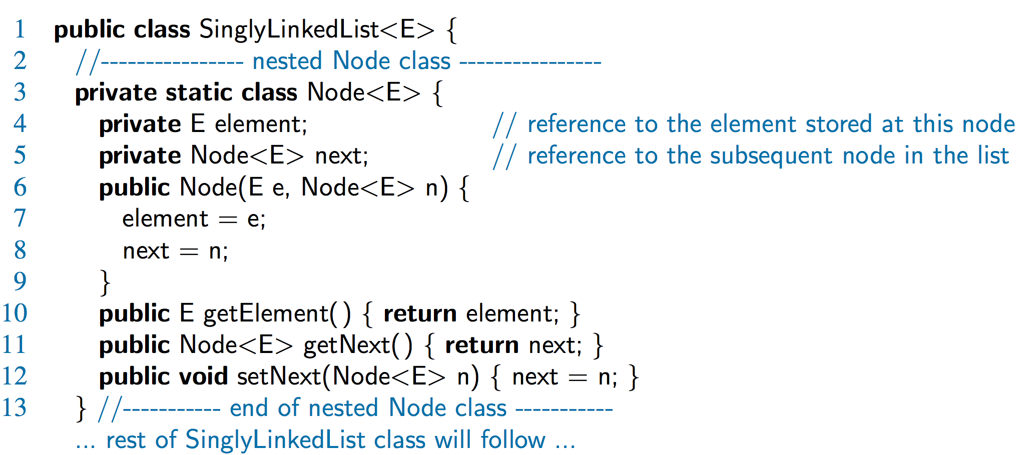
A Nested Node Class

Slide 5
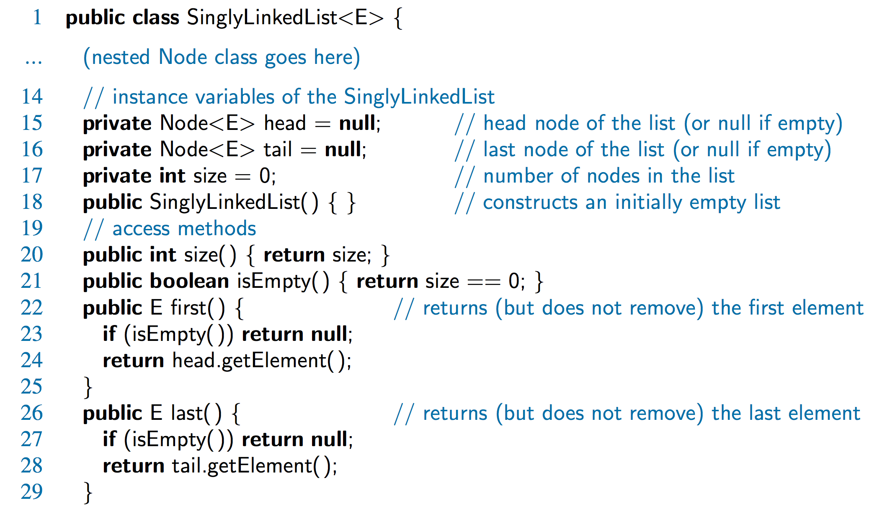
Accessor Methods

Slide 6
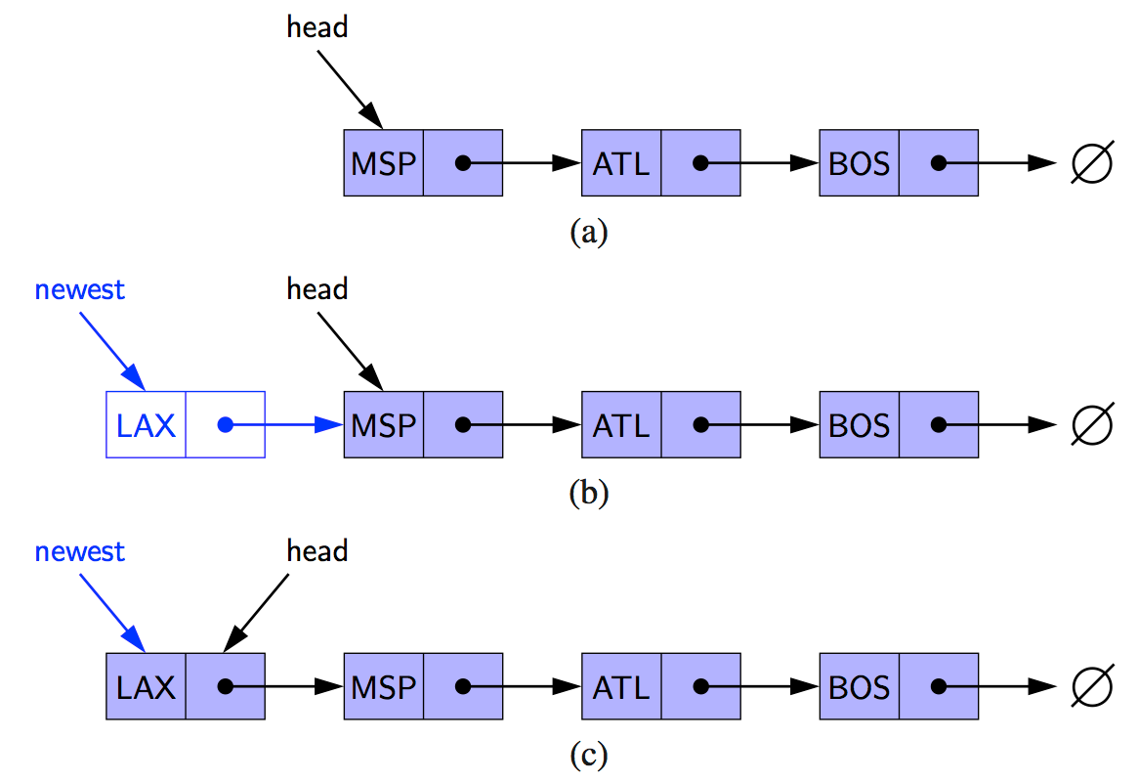
Inserting at the Head
Allocate new node
Insert new element
Have new node point to old head
Update head to point to new node

Slide 7
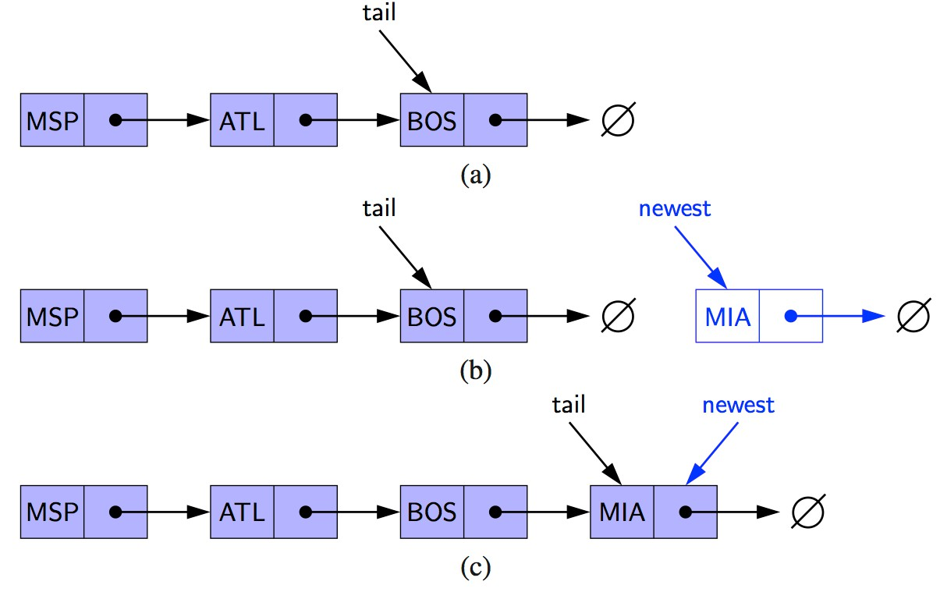
Inserting at the Tail
Allocate a new node
Insert new element
Have new node point to null
Have old last node point to new node
Update tail to point to new node

Slide 8
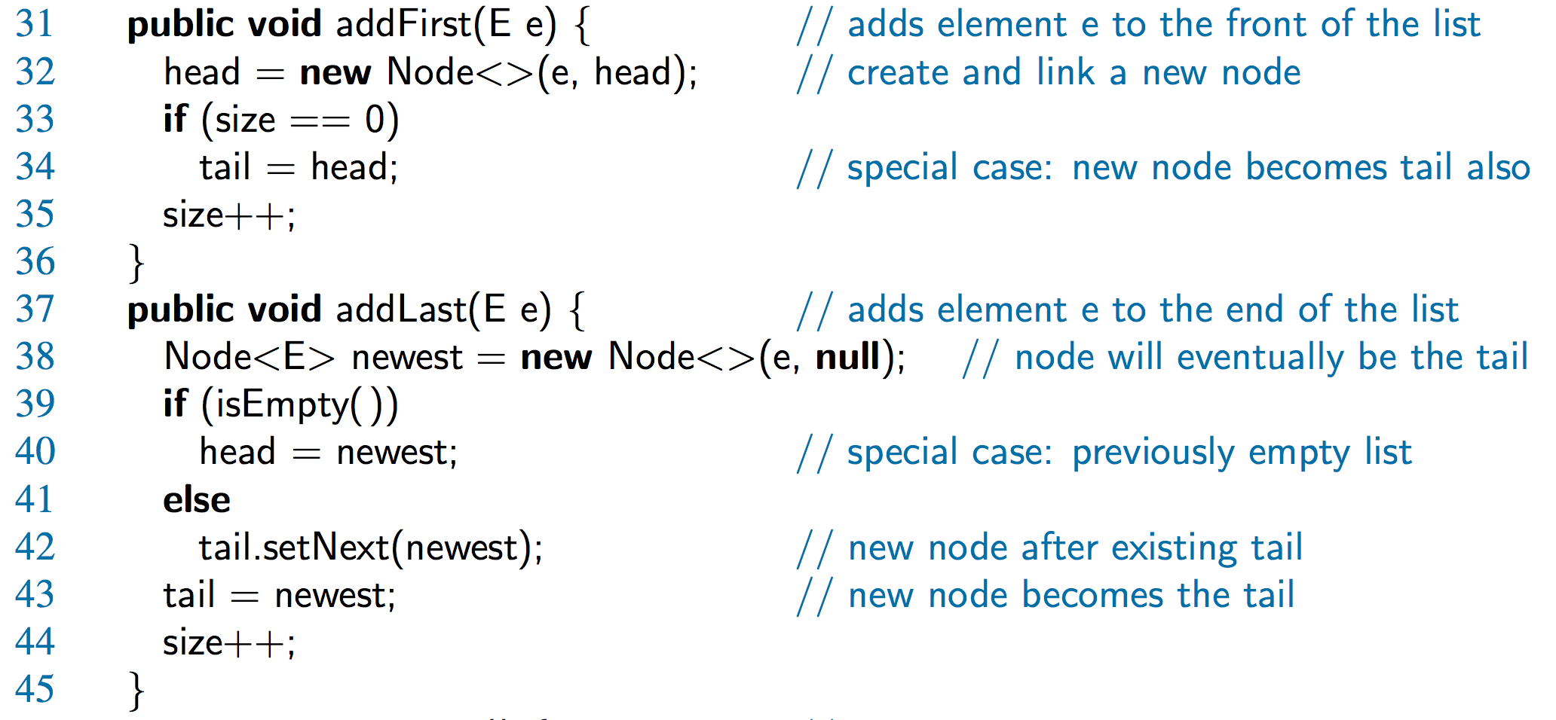
Java Methods

Slide 9
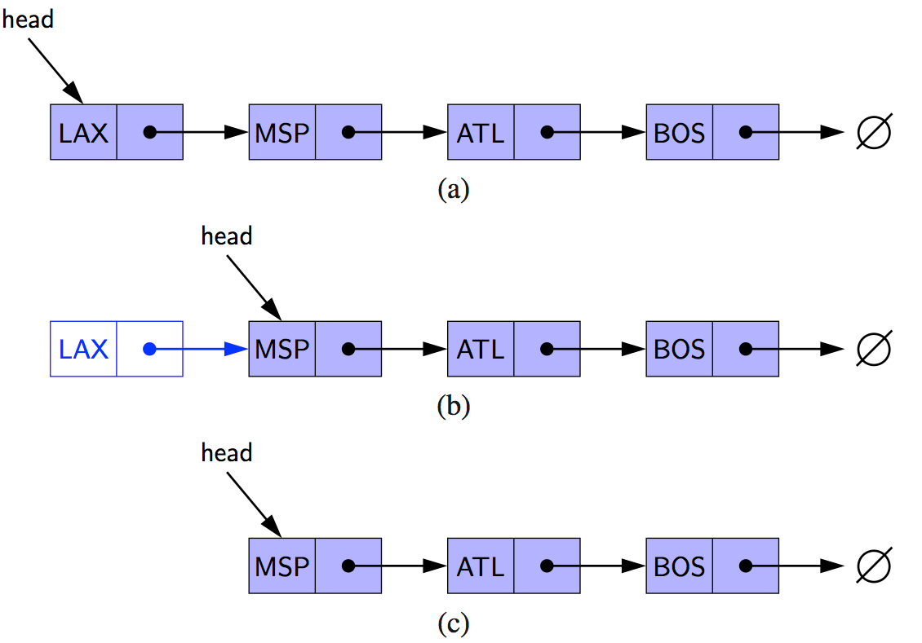
Removing at the Head
Update head to point to next node in the list
Allow garbage collector to reclaim the former first node

Slide 10
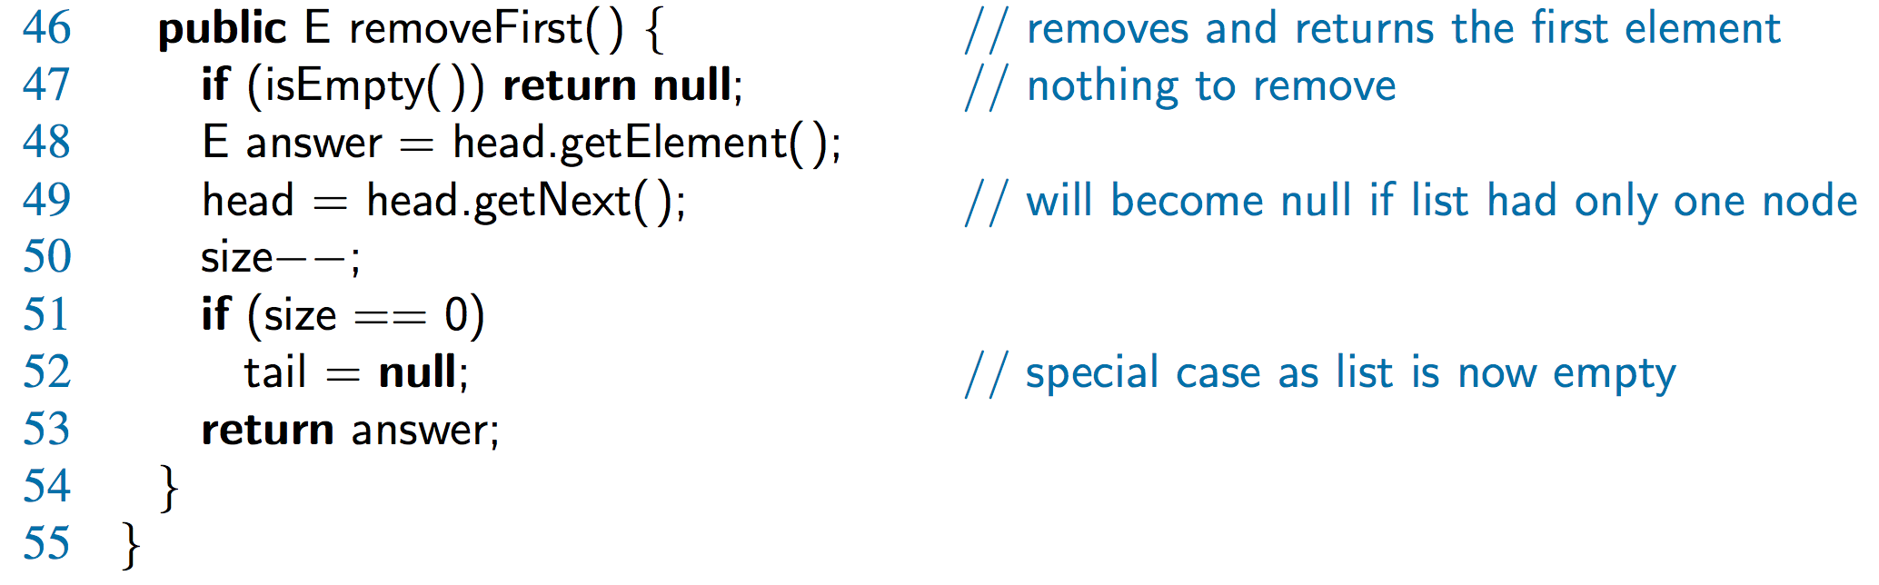
Java Method

Slide 11
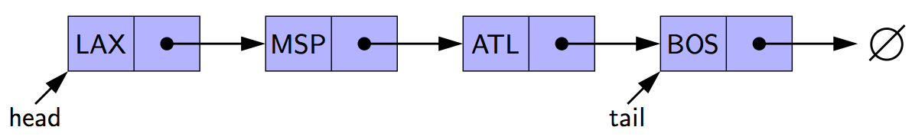
Removing at the Tail
Removing at the tail of a singly linked list is not efficient!
There is no constant-time way to update the tail to point to the previous node

Slide 12

Introduction to Linked Lists
Arrays and Linked Lists are different in
  use of memory
  manner of access
  language support

Slide 13
Nodes of a Linked-List
A node in a linked list is an object that holds some important information, such as a string, plus a link to the exact same type of object, i.e. to an object of the same class.
Self-referential class A class that includes an instance variable or variables that can hold a reference to an object of the same class

Slide 14
Example
We want to create a singly linked list, whose node contains one string
So each node has a field for a string value, and a pointer to the next node
We also need to specify the head node
The next node of the end node should be null
Problem
  Define the class Node
  Define the class SLinkedList

Slide 15
Class Node
public class Node {
private String element;
private Node next;
/** Creates a node with the given element and next node. */
public Node(String s, Node n) {
element = s; next = n;
}
public Node(String s) {
element = s; next = null;
}
// Accessor methods:
public String getElement() { return element; }
public Node getNext() { return next; }
// Modifier methods:
public void setElement(String newElem) { element = newElem; }
public void setNext(Node newNext) { next = newNext; }
}

Slide 16
Class SLinkedList
// Singly linked list .
public class SLinkedList {
protected Node head; // head node of the list
protected long size; // number of nodes in the list
// Default constructor that creates an empty list
public SLinkedList() {
head = null;
size = 0;
}
// ... add, update, search, delete, display methods would go here ...
}

Slide 17
Insertion at the head
Algorithm addFirst(v)
v.setNext(head) // make v point to the old head
head ← v // make variable head point to new node
size ← size + 1

Slide 18
Insertion at the tail
Need to keep a reference tail.
Algorithm addLast(v)
v.setNext(null) // make v point to null
tail.setNext(v). //old tail points to v
tail ← v // make v new tail
size ← size + 1 // increment the node count

Slide 19
Insertion in the middle
Develop an algorithm to insert in the middle of a singly linked list
addAfter(v, x)

Slide 20
Removing a node
Remove the head
Remove the tail
Remove a node v

Slide 21
Exercises
Reimplement the number counting project with a linked list
Reimplement the letter counting project with a linked list

Slide 22
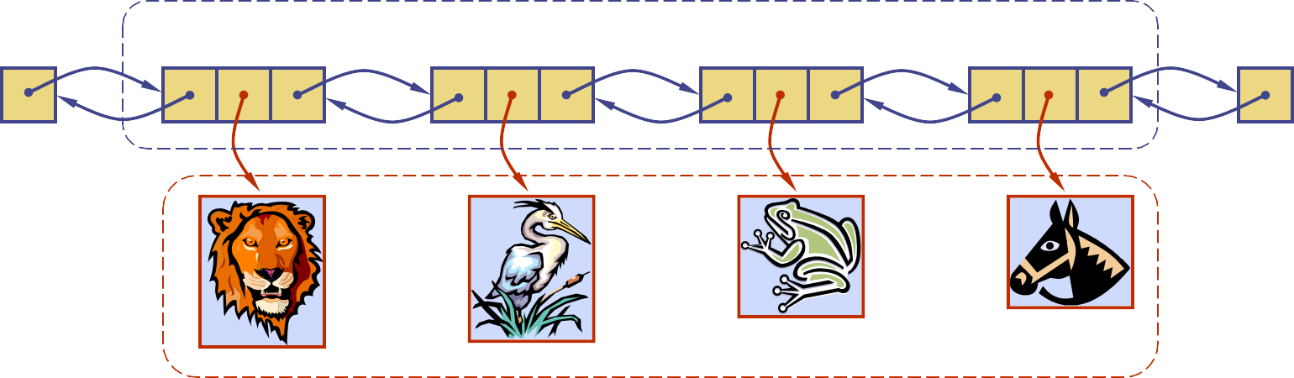
Doubly Linked List
A doubly linked list can be traversed forward and backward
Nodes store:
  element
  link to the previous node
  link to the next node
Special trailer and header nodes
prev
next
element
node
header
nodes/positions
trailer
elements
© 2014 Goodrich, Tamassia, Goldwasser
Doubly Linked Lists
1

Slide 23
Insertion
Insert a new node, q, between p and its successor.
p
A B C
p
A B
q
C
X
p
q
X
C

Slide 24
Deletion
Remove a node, p, from a doubly linked list.
p
A
B
C
D
A
B
C
p
D
X
C

Slide 25
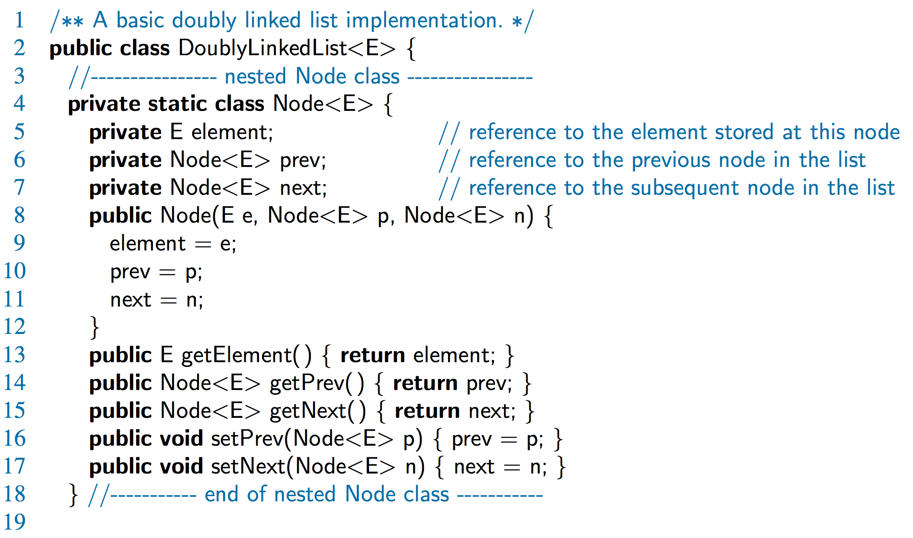
Doubly-Linked List in Java

Slide 26
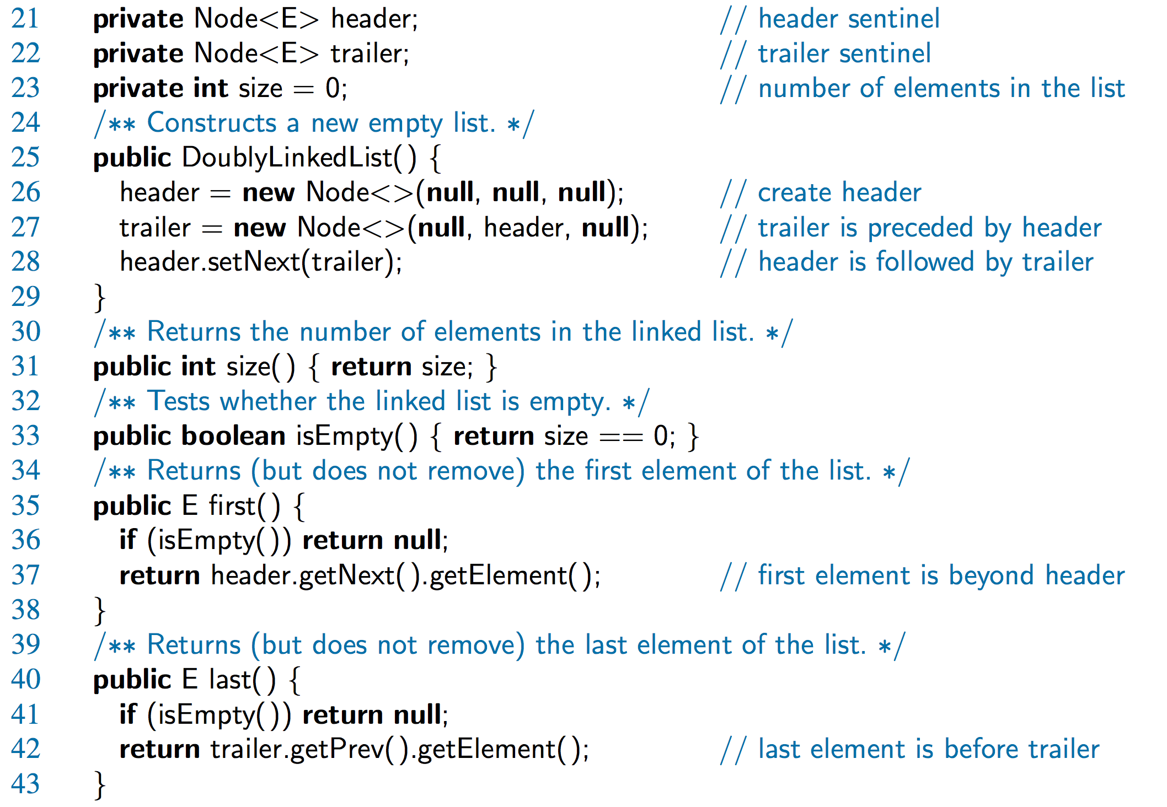
Doubly-Linked List in Java, 2

Slide 27
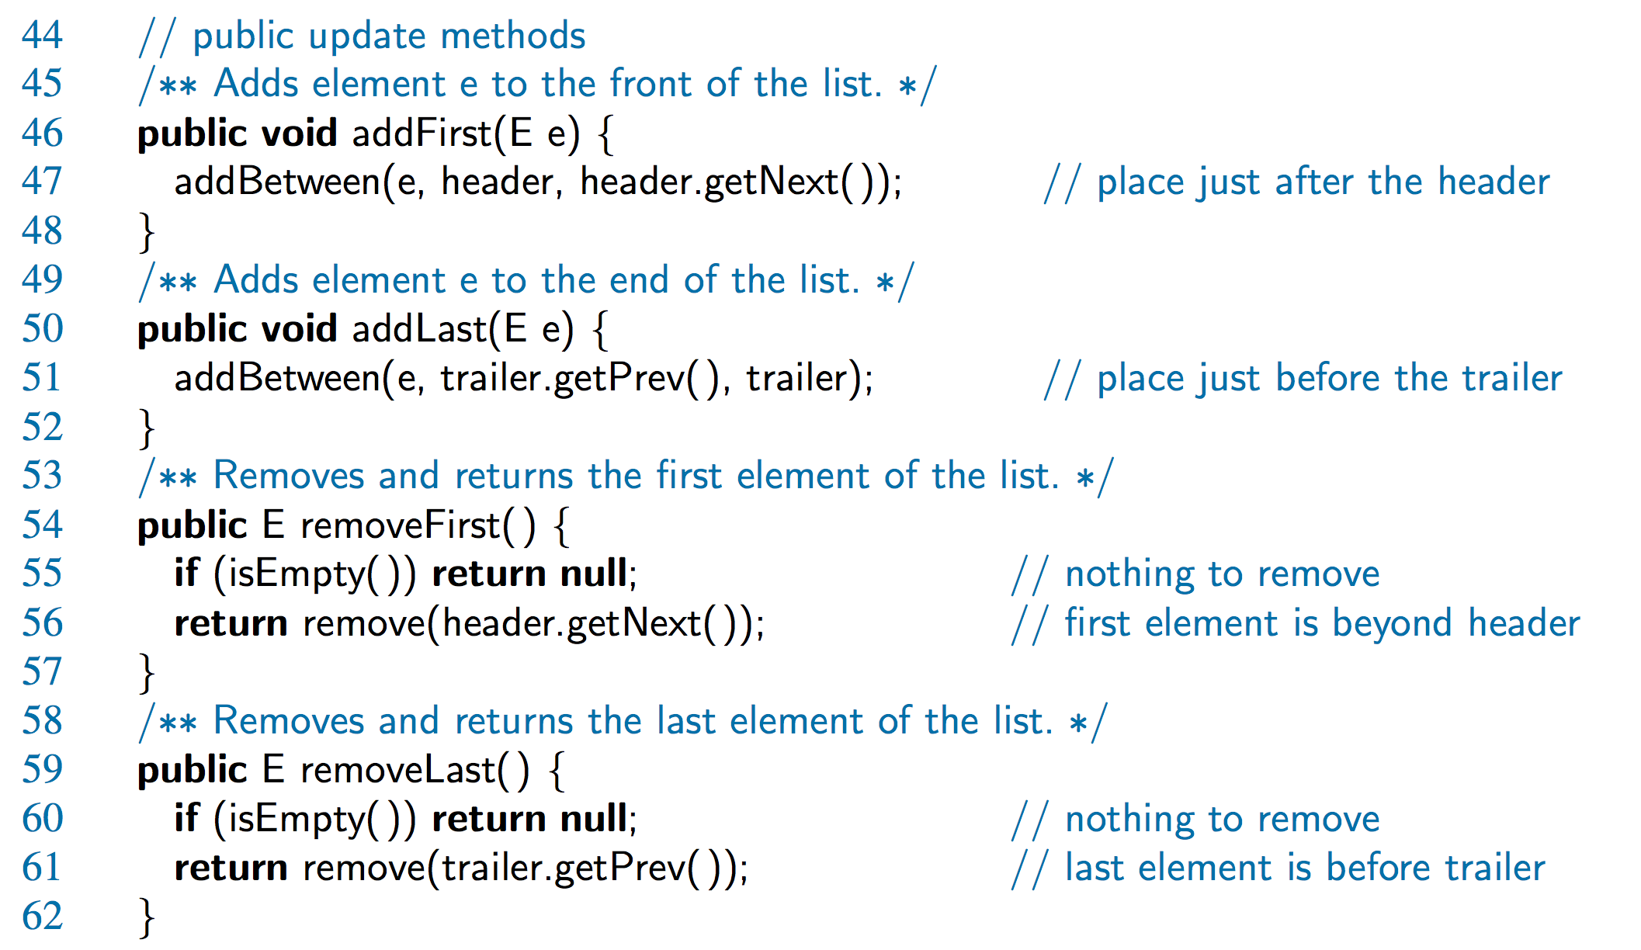
Doubly-Linked List in Java, 3

Slide 28
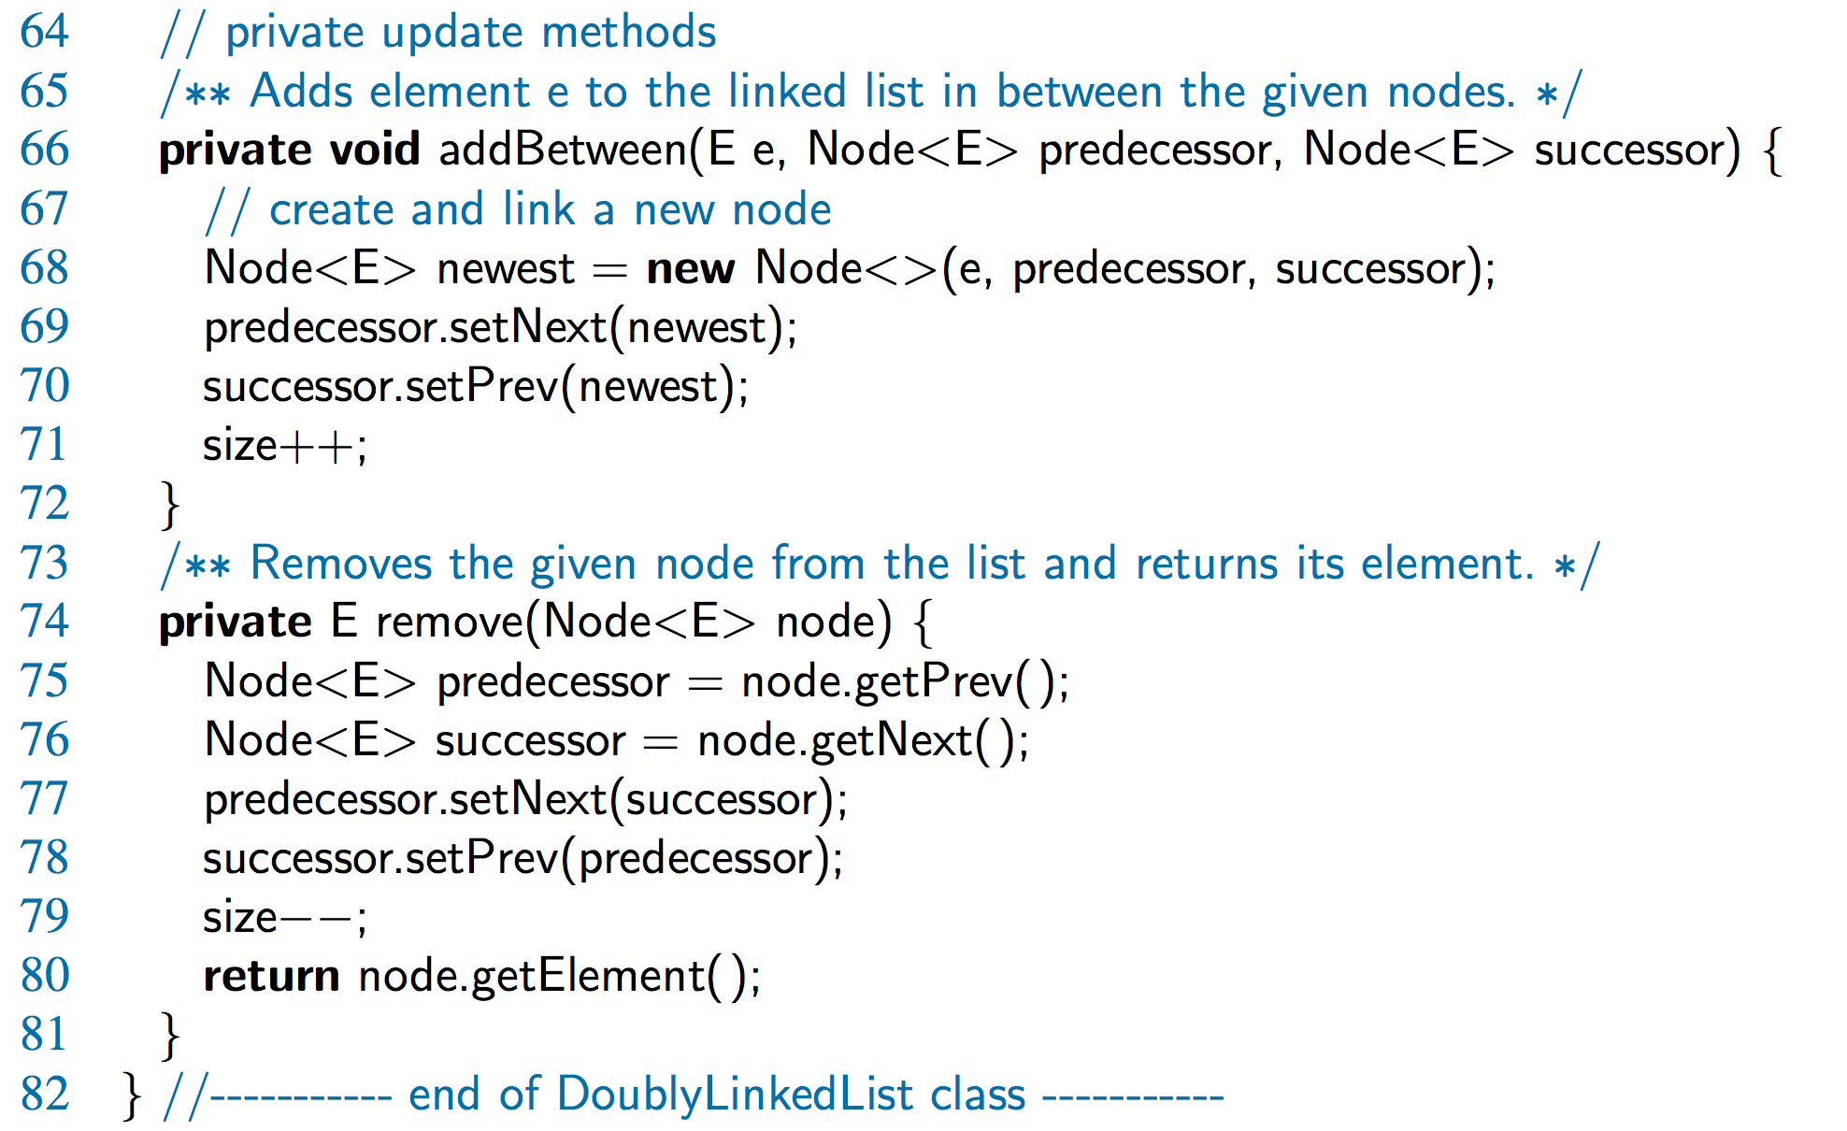
Doubly-Linked List in Java, 4

Slide 29
Java LinkedList<E> Class
https://docs.oracle.com/javase/7/docs/api/java/util/LinkedList.html
java.lang.Object
  java.util.AbstractCollection<E>
    java.util.AbstractList<E>
      java.util.AbstractSequentialList<E>
        java.util.LinkedList<E>
E – the type of elements held in the nodes
All Implemented Interfaces:
  Serializable, Cloneable, Iterable<E>, Collection<E>, Deque<E>,
  List<E>, Queue<E>

Slide 30
Java LinkedList<E> Class
public class LinkedList<E>
extends AbstractSequentialList<E>
implements List<E>, Deque<E>, Cloneable, Serializable
Constructor
LinkedList()

Slide 31
Java LinkedList<E> Class
Commonly used methods
add(E e) – append e to the end of the list
addFirst(E e) – insert e at the beginning of the list
addLast(E e) – append e to the end of the list
add(int index, E e) – insert e at position index of the list
contains(Object o) – returns true if the list contains o
element() – returns the first element
get(int index) – returns element at position index
getFirst(), getLast()
remove() – remove the head
remove(Object o), removeFirst(), removeLast()
size()
toArray() – returns an array containing all elements in the list
listIterator(int index) – returns a list-iterator of the elements in the list, starting at position index

Slide 32
Iterator and Iterable
The iterator data type supports
  hasNext(): test whether there are elements left in the iterator
  next(): return the next element in the iterator
The iterable data type supports
  itrerator(): return an iterator of the elements in the collection
Example: java.util.Scanner class has
hasNext()
next()
hasNextType() Type: Boolean, Byte, Double, Float, Int, Long, or Short
hasNextLine()
nextLine()

Slide 33
//example 1
import java.util.LinkedList;
public class StringList {
public static void main(String[] args) {
LinkedList<String> l = new LinkedList<String>();
l.add("Mike");
l.add("Jane");
l.add("Tom");
String[] arr = l.toArray(new String[l.size()]);
for (String a : arr) {
System.out.println(a);
}
System.out.println();
}
}

Slide 34
Exercise: student list
Using java.util.LinkedList, build a list of students, and play with the list (add, remove, display ..)
public class Student {
private String name;
privare double GPA;
Student(String str, double gpa){
name = str;
GPA = gpa;
}
public void display() {
System.out.println(name+", "+GPA);
}
}

Slide 35
Exercise: bankAccount list
Using java.util.LinkedList, build a list of bank accounts, add methods:
  create account (accNum, amount)
  withdraw (accNum, amount)
  deposit (accNum, amount)
  account balance total (sum of balances of all accounts)
  display all accounts that has a balance over certain amount, e.g. $100,000
Q: What if we need to print out all transactions for any given account?

